Slide 1
Pied Piper
CSC302

Slide 2
TABLE OF CONTENTS
01
DEMO
02
ARCHITECTURE
03
METHODOLOGY
04
DELIVERABLES
Notes:
- demo
- architecture
- methodology
- deliverables

Slide 3
DEMO

Slide 4
LEARNING GOALS
Learn how to design distributed systems
Learn React/Redux
Dividing work in a team
Notes:
- weren't familiar with microservices or distributed systems, so wanted to learn more
- some of us wanted to cover some weaker frontend points, React/Redux
- last point may not seem important, but rare to work in a large team

Slide 5
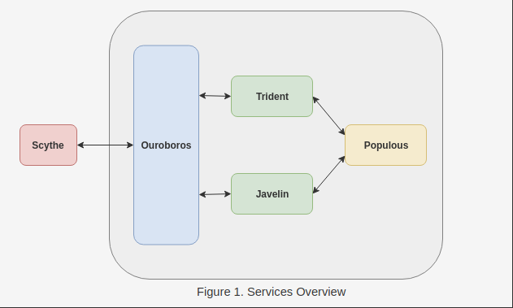
ARCHITECTURE
Scythe: Frontend
Ouroboros: Gateway API
Trident: Ticket Service
Javelin: GAPF Service
Populous: User Service

Slide 6
ORCHESTRATION
Docker
Kubernetes
gRPC
Notes:
- used

Slide 7
PROJECT STRATEGY
01
02
03
PLAN
THE OBSTACLES
THE FINISH
We initially set milestones based on dividing the goals into sets of tasks
These milestones would then be divided into individual tasks for a SCRUM Sprint run
However, the milestone deadlines were delayed because of a few obstacles
-Allow users to attach documents to their GAPF application
Setting up Kubernetes/Docker
Understanding GRPC and ES6 protocols
Poor distribution of tasks based on the available team strengths initially
Underestimating the learning curve for JavaScript/React/Redux
After dropping some of the goals, as mentioned earlier, the rest of the goals should be achieved in time.
We will try to be more accurate as a group at assigning tasks and updating the GitHub Projects.

Slide 8
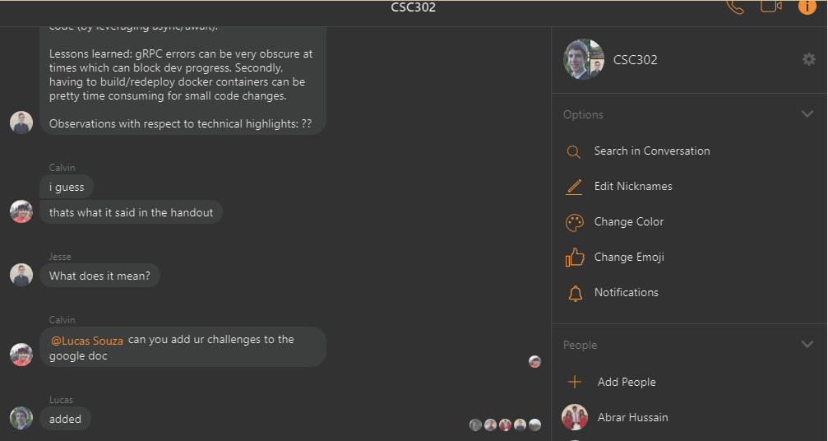
PRODUCT DEVELOPMENT PROCESS
01
COMMUNICATION
Mainly communicated through Messenger
Used Hangouts for meetings

Slide 9
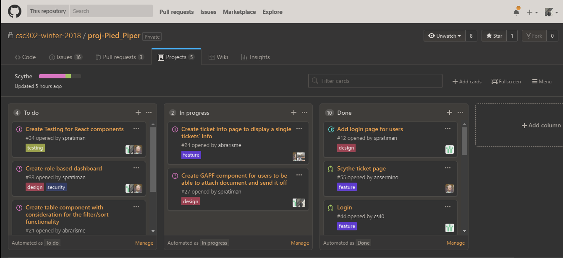
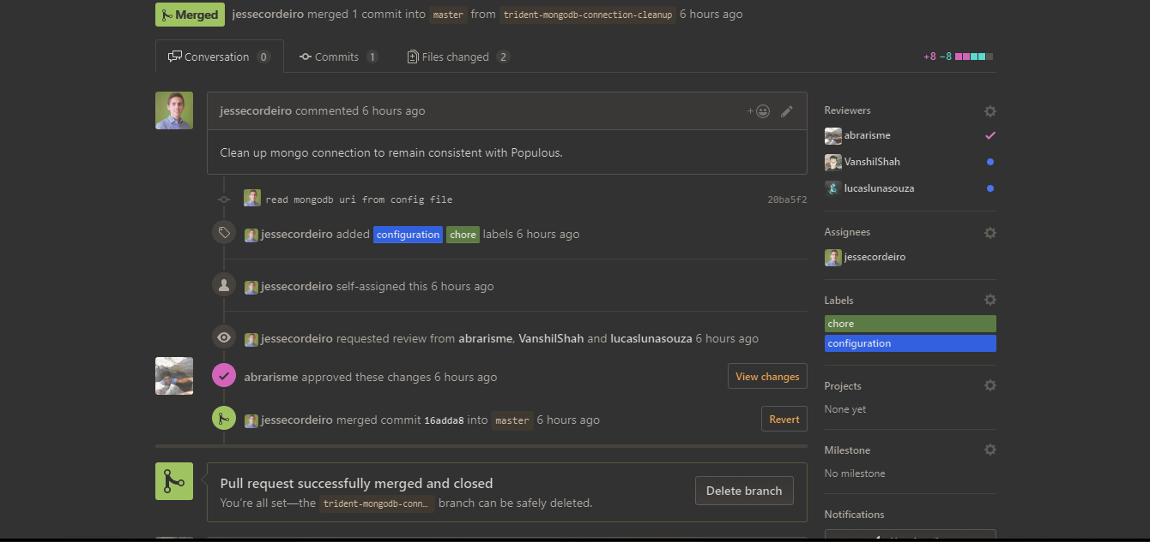
02
AGILE/ KANBAN
03
IMAGINATION
Board
Notes:
- used SCRUM method with Kanban boards
- Pratiman master responsible for creating and assigning tickets

Slide 10
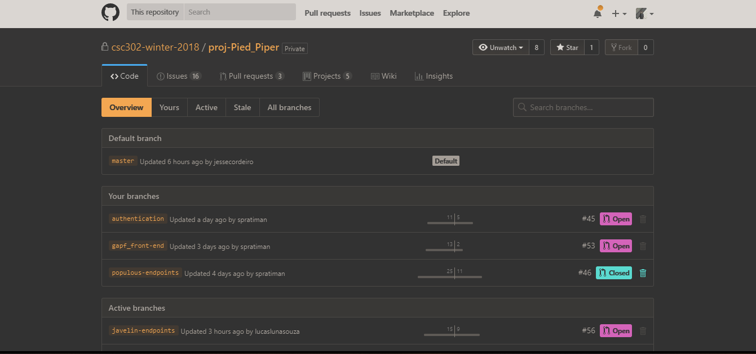
03
ISSUE TRACKING/GitHub Issues
Pull Requests

Slide 11
TEST STRATEGY
Create tests for our own services
Used JEST library
Tested individual functions
Notes:
- show demo of npm run test

Slide 12
INTENDED TECHNICAL DELIVERABLES
PO Goals | P1 Goals | P2 Goals
Allow users to submit GAPF application info (excluding attachments). | User filter in the ticket dashboard on features such as applicant country or state | Send email updated to actors for ticket state changes.
Allow budget director and grad office staff to view GAPF application status. | Create a list that specifies “next-tasks” for actors. | Allow users to attach documents to their GAPF application.
Allow all actor interactions with tickets to change ticket state according to the specified use cases | Add security using JWT tokens to incoming network requests. | Add distributed tracing functionality to the backend services
Allow users to add notes to tickets |  | Add urgent notifications through email for different actors
Create a ticket dashboard which allows actors to see all tickets

Slide 13
FINAL STATUS
COMPLETED
ELIMINATED
P0 Goals:
-Users are able to create a ticket.
-Allow users to add notes to tickets
-Allow users to submit GAPF application info
-Create a ticket dashboard which allows actors to see all tickets
P1 Goals:
-Add security using JWT tokens to incoming network requests
-Use filter in the ticket dashboard based on features such as applicant country or state.
P2 Goals:
-Allow users to attach documents to their GAPF application
P1 Goals:
-Create a list that specifies “next-tasks” for actors
P2 Goals:
-Send email updates to actors for ticket state changes
-Add urgent notifications through email for different actors

Slide 14
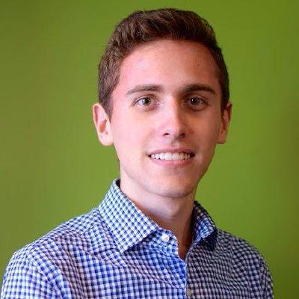
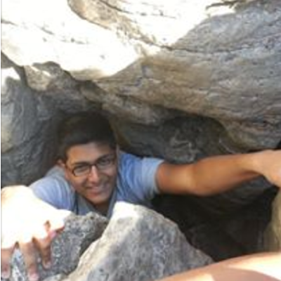

CONTRIBUTIONS
Jesse
Abrar
Lucas
Implement Populous endpoints
Write tests for Populous service
Set up MongoDB on Atlas for the application
Set up Kubernetes and initial code for frontend/backend and Wiki
Added frontend navigations
Added backend GAPF endpoints
Implemented Javelin endpoints
Wrote Javelin test cases

Slide 15
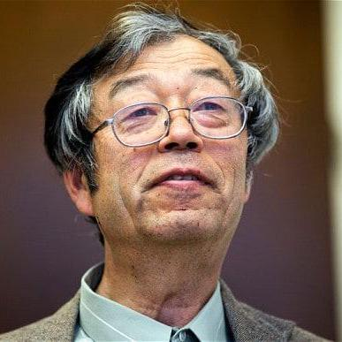
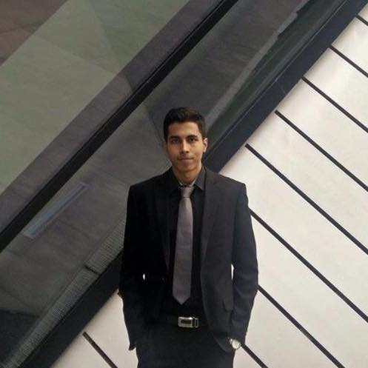
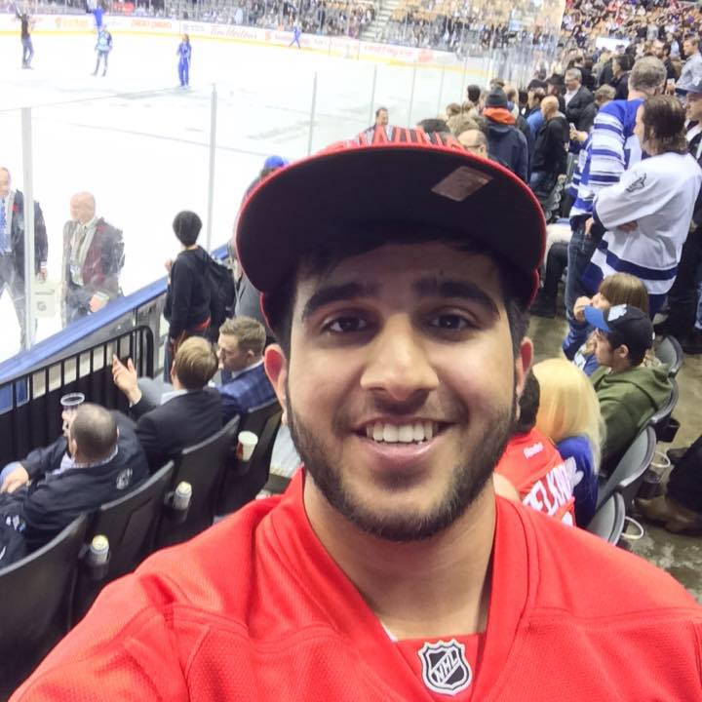
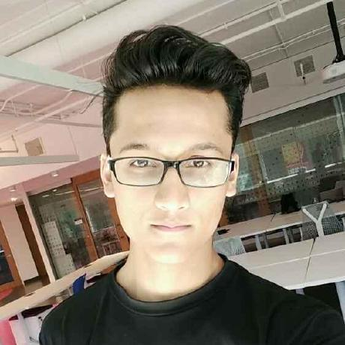
CONTRIBUTIONS
David
Pratiman
Calvin
Vanshil
Set up boilerplate code for React/Redux
Designed front-end views
Added role-based authentication with JWT tokens
Design Upload to GAPF page with Calvin
KANBAN tickets
Design the Login page
Design Upload to GAPF page
Designed Redux logic to get tickets

Slide 16
THANK YOU
ANY QUESTIONS?

